Slide 1

Uk Poverty and inequality trends 1969 - 2017 : Insights from the world bank pip dataset
Source:
The World Bank Poverty and Inequality Platform (PIP) Dataset
Author: Teresa McGarry
https://pip.worldbank.org/home

Slide 2
Individual formative assignment Outcomes
Design and implement an ETL pipeline using Python.
Visualise data using Matplotlib, Seaborn, and Plotly.
Adhere to the key milestones and deliverables.
Maximise future maintainability through documentation, code structure, and organisation.
Document and present the project process and outcomes.
Demonstrate and document the development process through a version control system such as GitHub.

Slide 3
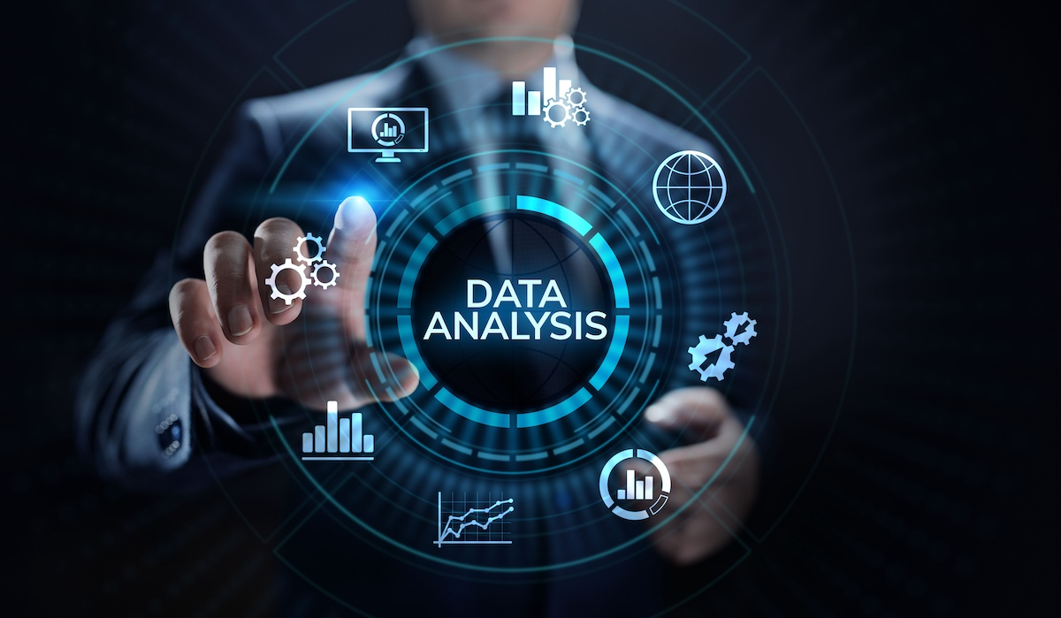
Introduction

Slide 4
Timelne of historical events 1969-2017

Slide 5
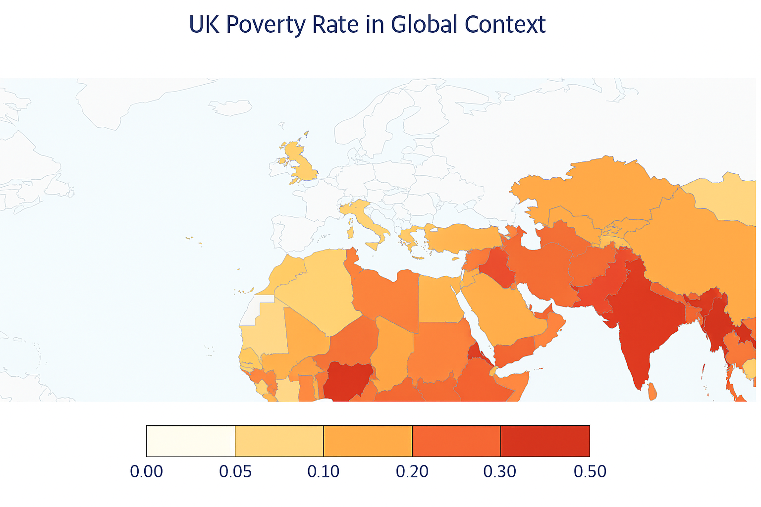
The PIP Dataset
The PIP dataset provides harmonized poverty and inequality measures across countries and time. Using it ensures that UK trends can be benchmarked against:
International income standards: $2.15/day, poverty lines
Lower-middle income: $3.65/day, poverty lines
Upper-middle income: $6.85/day poverty lines).
The dataset provides consistent time-series data (1967 – present) allowing tracking of decades of poverty dynamics
For the UK this is especially important since extreme poverty (international line) is rare, but relative poverty remains an issue
In a high-income country like the UK, the upper-middle income poverty line ($6.85/day) is the most appropriate one to review
Line Colour | Poverty Line Definition | Interpretation
🔵 Blue | International poverty line (e.g., $2.15/day) | Extreme poverty
🔴 Red | Lower-middle-income countries poverty line (e.g., $3.65/day) | Deprivation
🟢 Green | Upper-middle-income countries poverty line (e.g., $6.85/day) | Relative poverty & social exclusion

Slide 6
Key variables
Variable name | Variable of interest
Mean | The mean level of income or expenditure per day.
Median | The level of income or expenditure per day below which half of the population live.
Palma Index/Ratio | A measure of income inequality that compares the richest 10% to the poorest 40% of a population. It was developed as an alternative to the Gini coefficient, aiming to better capture disparities at the extremes of the income distribution.
Polarization | The growing divide between high-income and low-income groups, often accompanied by the shrinking of the middle class. It’s a key concept in understanding inequality trends, especially in advanced and globalizing economies.
Gini Index | A measure of income or wealth inequality within a population. It tells you how evenly income or consumption is distributed.
MLD (Mean Log Deviation) | A measure of income inequality that emphasises disparities at the lower end of the income distribution. It’s part of the generalised entropy class of inequality metrics and is especially sensitive to changes among the poorest.
Income Gap Ratio | The mean shortfall in income or consumption from the poverty line, expressed as a percentage of the poverty line, counting the non-poor as having zero shortfall.
Average Income Shortfall | The average shortfall from the International Poverty Line per day (averaged across population in poverty).
Headcount ratio | % of population living in households with an income or expenditure per person below the International Poverty Line ($2.15 a day in 2017 prices).
Poverty Gap Index | The depth of poverty by calculating how far below the poverty line poor individuals fall, on average, expressed as a percentage of that line. It complements the poverty headcount ratio by showing not just how many are poor, but how poor they are

Slide 7
Issues
Issue | Resolution
GDP file would not load correctly | Converted it to Excel and specified where to start reading the data from

Slide 8
Executive Summary

Slide 9
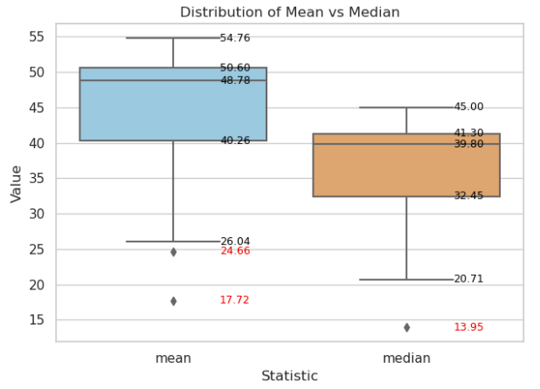
Mean and Median: The mean is higher than the median. This implies a positively skewed distribution
A few outliers for both mean and median

Slide 10
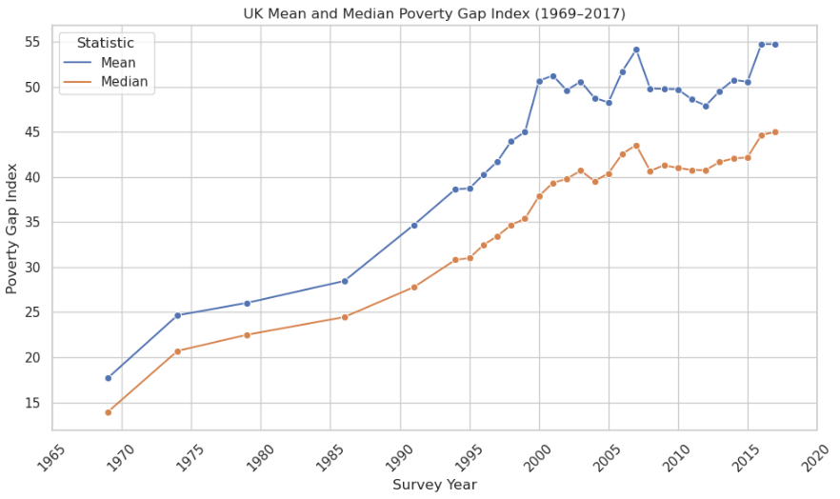
Mean and Median: The consistently higher mean implies rising inequality among the poor. Of the 5 largest gaps between mean and median 3 are in the period 2000-2003
Interpretation
The depth of poverty is increasing — i.e., poor individuals are further below the poverty line on average (mean) and at the midpoint (median).
As the mean is consistently higher than the median this means a small number of very poor individuals pull the mean upward
Year | Largest gaps
2000 | 12.80
2001 | 11.91
2007 | 10.58
2016 | 10.08
2003 | 9.89

Slide 11
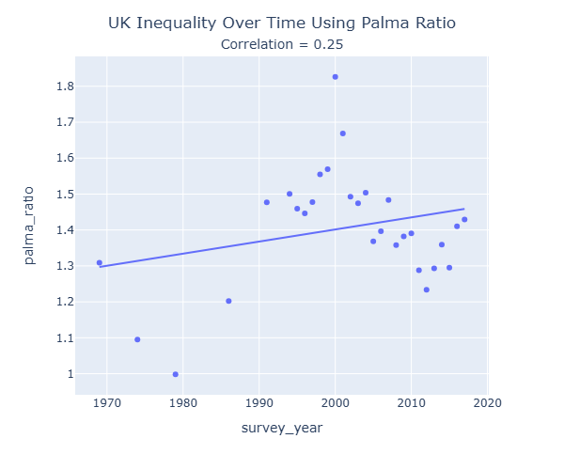
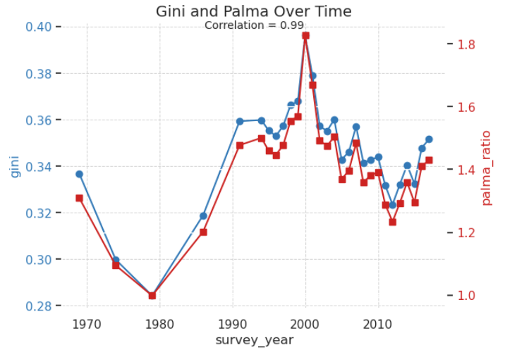
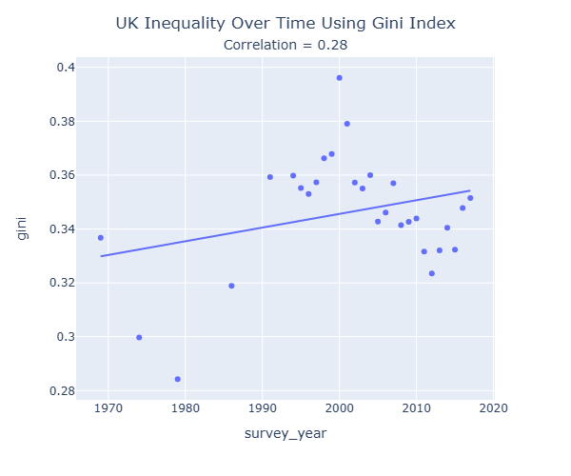
Palma Ratio and Gini Index: Both show inequality has risen steadily over time

Slide 12
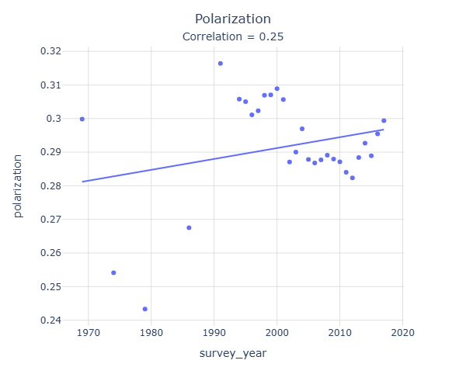
Polarization: Another weak but positive trend in polarization over time

Slide 13
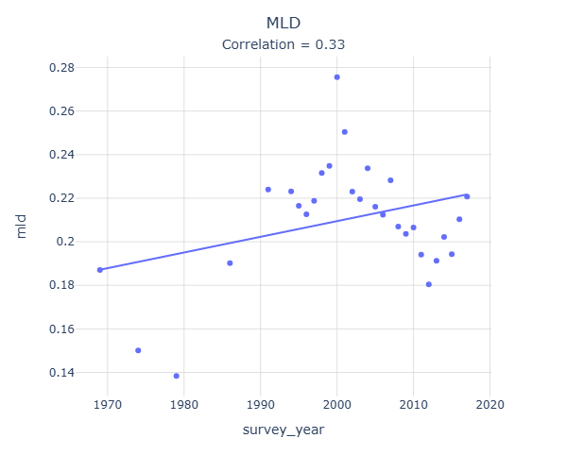
MLD: A slightly stronger positive relationship between time and inequality but again a consistent trend rather than being highly predictive

Slide 14
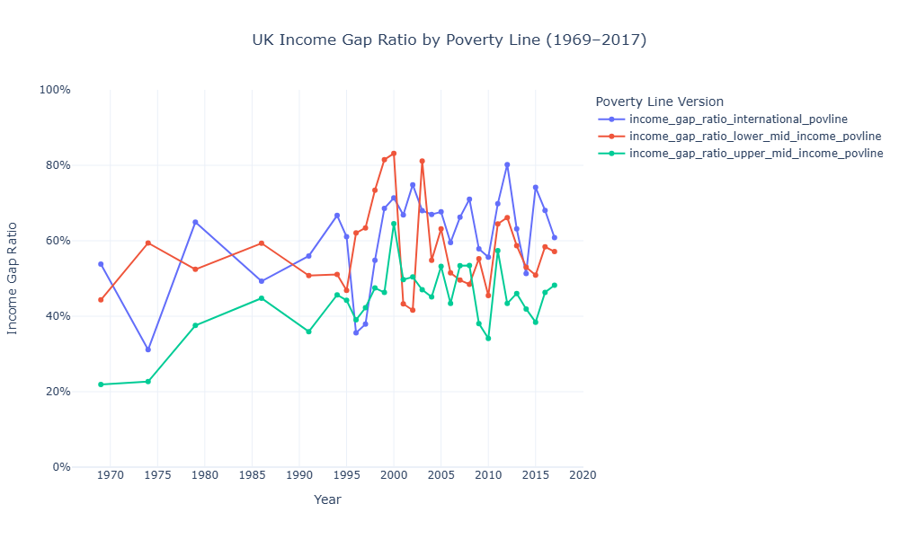
Income Gap Ratio: Whilst each poverty measure shows a persistent incline over time, the ‘income gap ratio upper mid income povline’ shows the biggest increase. The blue International poverty line is designed for low-income countries and so in the UK may understate poverty. Hence the red and green lines give a better indication of poverty., capturing relative deprivation and social exclusion
Line Colour | Poverty Line Definition | Interpretation
🔵 Blue | International poverty line (e.g., $2.15/day) | Extreme poverty
🔴 Red | Lower-middle-income countries poverty line (e.g., $3.65/day) | Deprivation
🟢 Green | Upper-middle-income countries poverty line (e.g., $6.85/day) | Relative poverty & social exclusion

Slide 15
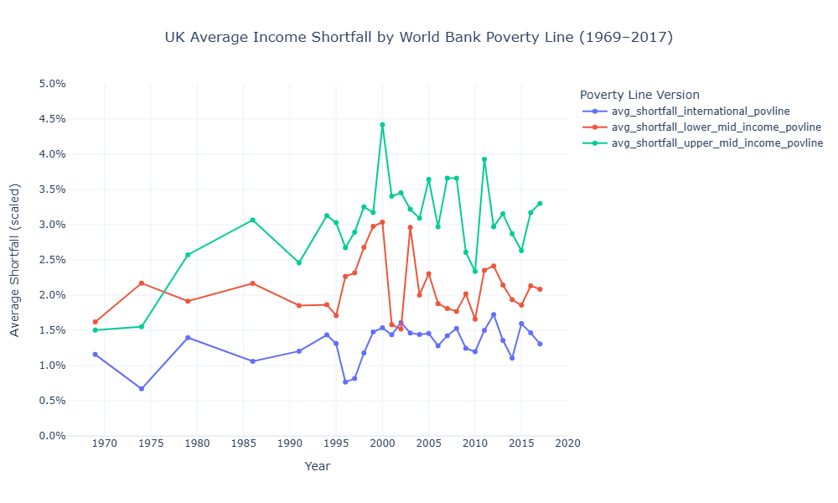
Average Income Shortfall: The UK’s poor are increasingly far below the poverty line, with notable spikes in each measure in 2000, likely caused by ????
Line Colour | Poverty Line Definition | Interpretation
🔵 Blue | International poverty line (e.g., $2.15/day) | Extreme poverty
🔴 Red | Lower-middle-income countries poverty line (e.g., $3.65/day) | Deprivation
🟢 Green | Upper-middle-income countries poverty line (e.g., $6.85/day) | Relative poverty & social exclusion

Slide 16
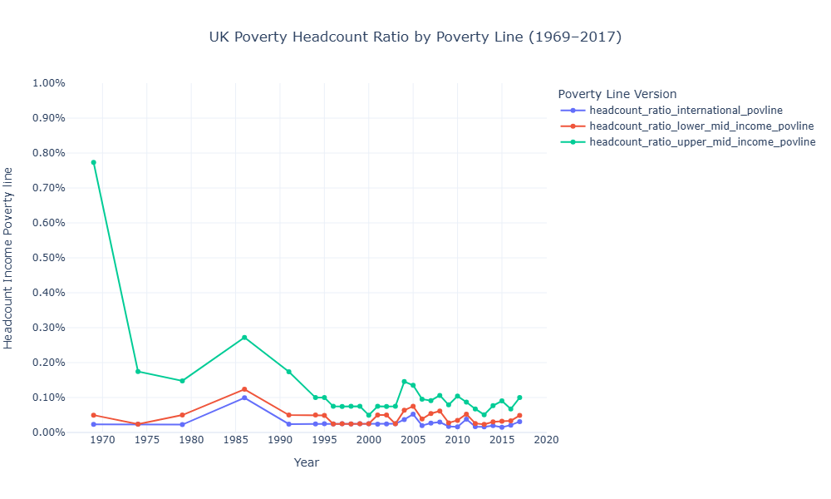
Headcount ratio: Whilst extreme poverty is nearly eradicated, relative poverty remain an issue
Line Colour | Poverty Line Definition | Interpretation
🔵 Blue | International poverty line (e.g., $2.15/day) | Extreme poverty
🔴 Red | Lower-middle-income countries poverty line (e.g., $3.65/day) | Deprivation
🟢 Green | Upper-middle-income countries poverty line (e.g., $6.85/day) | Relative poverty & social exclusion

Slide 17
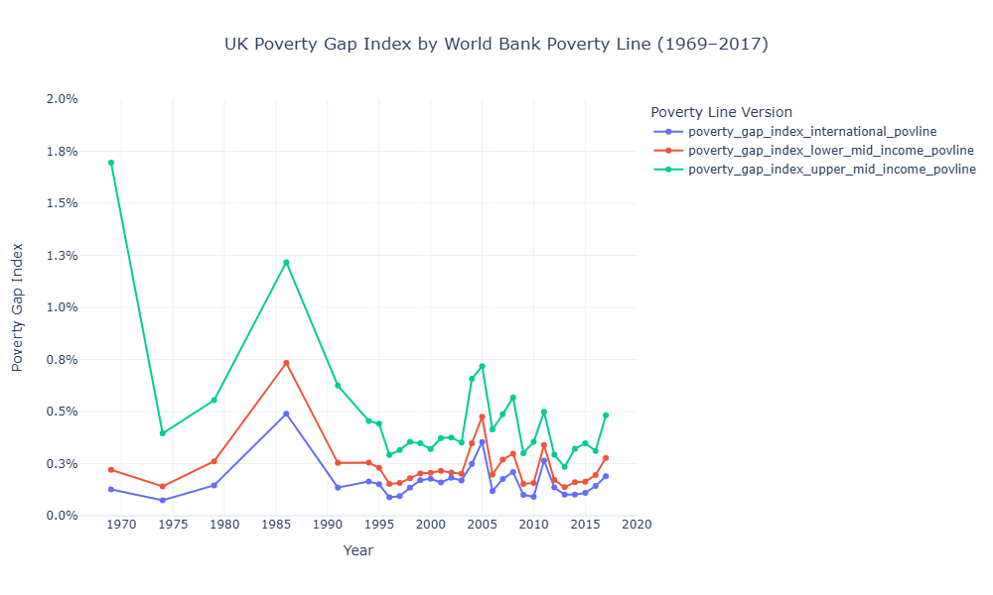
Poverty Gap Index: While extreme poverty is rare and stable, the upper-middle income line exposes deeper and more persistent deprivation. All lines show a peak in 1986, a time of high unemployment and reduced welfare support
Line Colour | Poverty Line Definition | Interpretation
🔵 Blue | International poverty line (e.g., $2.15/day) | Extreme poverty
🔴 Red | Lower-middle-income countries poverty line (e.g., $3.65/day) | Deprivation
🟢 Green | Upper-middle-income countries poverty line (e.g., $6.85/day) | Relative poverty & social exclusion
Poverty Gap Index
The poverty gap index measures the depth of poverty by calculating how far below the poverty line poor individuals fall, on average, expressed as a percentage of that line. It complements the poverty headcount ratio by showing not just how many are poor, but how poor they are

Slide 18
Appendix

Slide 19
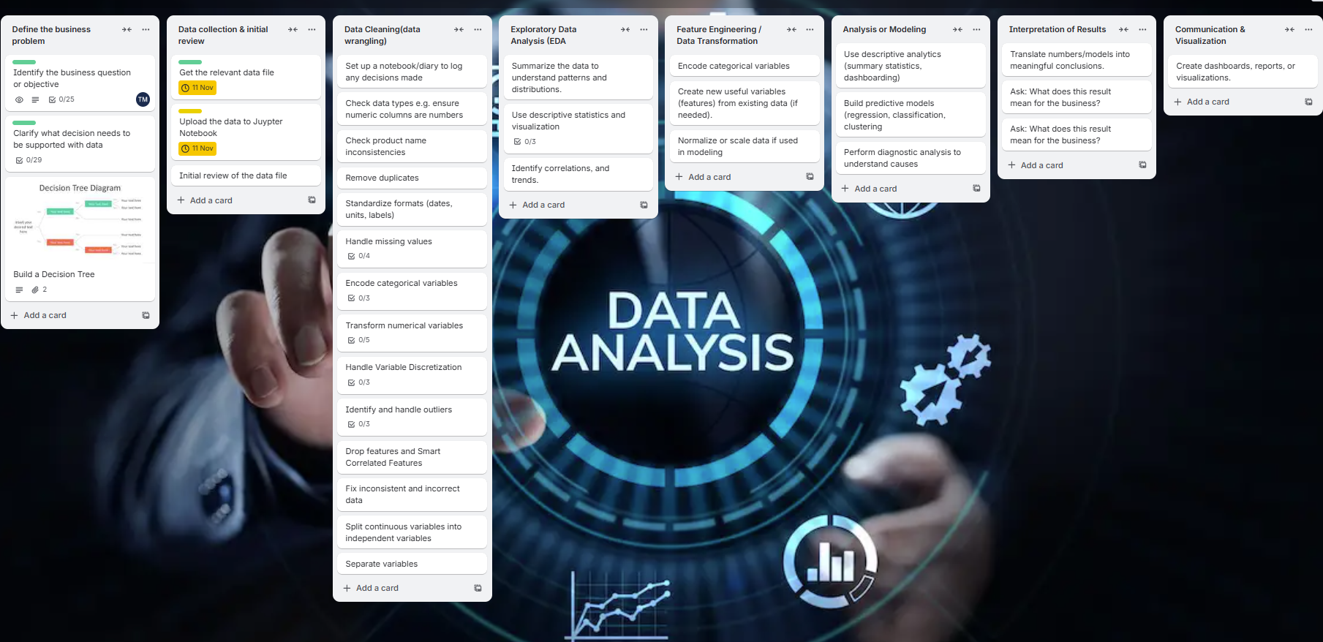
Project Management

Slide 20
The PIP Dataset
Dataset Summary | Explanation
Purpose and Scope | The Poverty and Inequality Platform (PIP) provides the World Bank’s official global poverty and inequality statistics.
Frequency and Coverage | Data cover roughly 1967–2022 (depending on country). Around 2,000+ surveys are included. Updated quarterly, as new national survey data and PPP revisions become available
Data Sources | The dataset is built primarily from national household surveys (income or consumption-based). These are harmonized using consistent welfare definitions and PPP adjustments, allowing global comparability across time and countries (1980s–present).
Core Indicators | Poverty headcount ratios at international poverty lines (e.g. $2.15, $3.65, $6.85 per day in 2017 PPP). Mean and median income or consumption. Gini index (inequality). Income shares held by different population deciles or quintiles
GDP Alignment and PPP | Monetary values in PIP are expressed in 2017 PPP (Purchasing Power Parity) international dollars ($2.15/day (extreme), $3.65 (lower-middle), $6.85 (upper-middle)). Nb The dataset contains both the 2011 and 2017 definition of PPP. In this analysis we will focus solely on the 2017 definition. For macroeconomic alignment, it uses World Development Indicators (WDI) GDP and population data to ensure country-year consistency

Slide 21
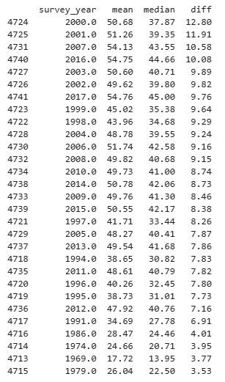
Mean and median gaps

Slide 22
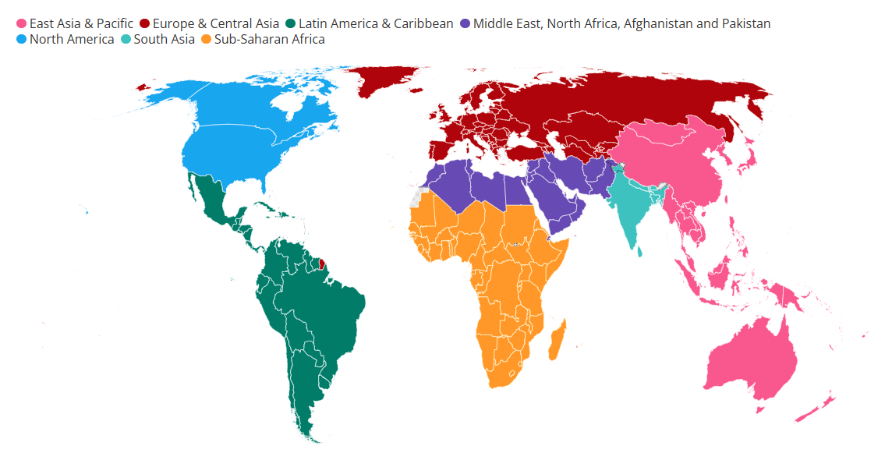
The world by region
The PIP dataset uses the World Bank regional classification
https://datahelpdesk.worldbank.org/knowledgebase/articles/906519-world-bank-country-and-lending-groups

Slide 23
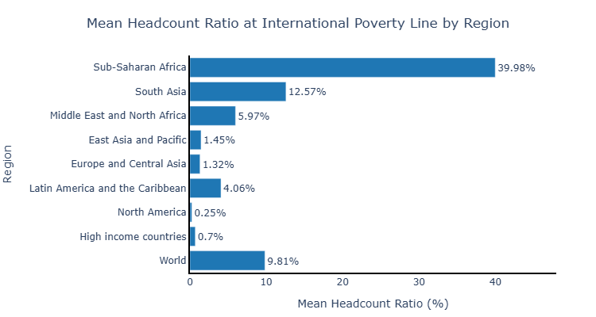
To what extent does economic growth reduce extreme poverty across world regions, and how does income inequality influence this relationship

Slide 24



Thank you
Teresa McGarry
teresa_mcgarry@hotmail.com
GitHub

